Slide 1

Computer System Servicing

Slide 2
Occupational Health and Safety (OHS)
Occupational Health and Safety (OHS) - is a planned system of working to prevent illness and injury where you work by recognizing and identifying hazards and risks. Health and safety procedure is the responsibility of all persons in the computer and technology industries. You must identify the hazards where you are working and decide how dangerous they are. Eliminate the hazard or modify the risk that it presents.

Slide 3
There are three steps used to manage health and safety at work:
1. Spot the Hazard (Hazard Identification)
2. Assess the Risk (Risk Assessment)
3. Make the Changes (Risk Control)

Slide 4
Hazard Identification
Hazard identification is part of the process used to evaluate if any particular situation, item, thing, etc. may have the potential to cause harm.
How do you identify a hazard?
To be sure that all hazards are found:
Look at all aspects of the work and include non-routine activities such as maintenance, repair, or cleaning.
Look at the physical work environment, equipment, materials, products, etc. ...
Include how the tasks are done.
Look at injury and incident records.

Slide 5
Hazard Identification
Why is hazard identification important?
As identification of hazards is the first step in Risk Management, it implies that hazards which are not identified would not go through the rigor of the Risk Management process, leading to the non-identification of preventive measures for implementation and communication to prevent harm in the workplace.

Slide 6
Risk Assessment
Risk assessment is a term used to describe the overall process or method where you: Identify hazards and risk factors that have the potential to cause harm (hazard identification). Determine appropriate ways to eliminate the hazard, or control the risk when the hazard cannot be eliminated (risk control).

Slide 7
Risk Assessment
The HSE suggests that risk assessments should follow five simple steps:
Step 1: Identify the hazards.
Step 2: Decide who might be harmed and how.
Step 3: Evaluate the risks and decide on precautions.
Step 4: Record your findings and implement them.
Step 5: Review your assessment and update if necessary.

Slide 8
Risk Control
Risk control is the set of methods by which firms evaluate potential losses and take action to reduce or eliminate such threats. Risk control also implements proactive changes to reduce risk in these areas. Risk control thus helps companies limit lost assets and income.

Slide 9
Risk Control
Risk control is the set of methods by which firms evaluate potential losses and take action to reduce or eliminate such threats. Risk control also implements proactive changes to reduce risk in these areas. Risk control thus helps companies limit lost assets and income.

Slide 10
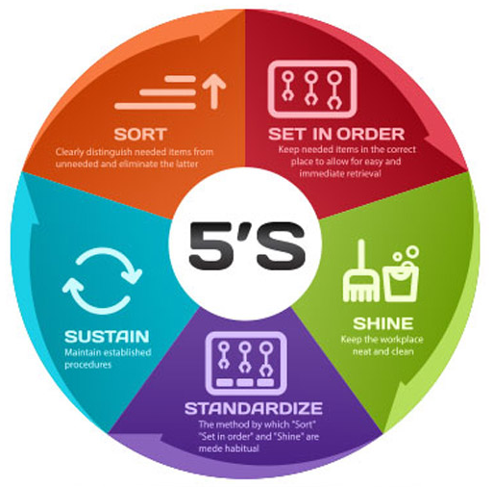
5s Principle
The principles of 5S are also commonly known as ‘lean management’ and were instigated by Toyota in the 1950s. The main purpose of 5S, also known as lean management, is to reduce waste and increase efficiency, thereby reducing production costs while increasing productivity, safety, and employee satisfaction.

Slide 11
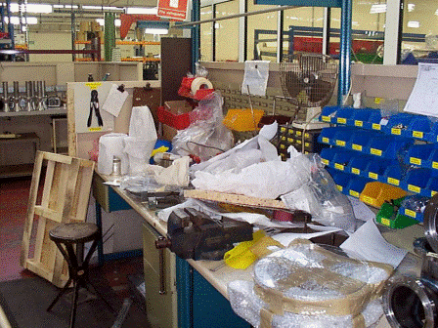
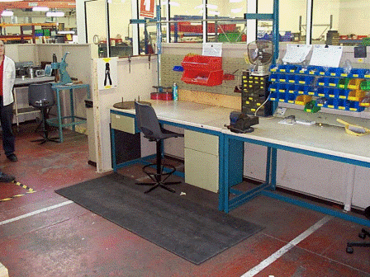
Sort (Seiri)
The first step to making your workplace more efficient is to sort through which items need to be there, and which items don’t.

Slide 12
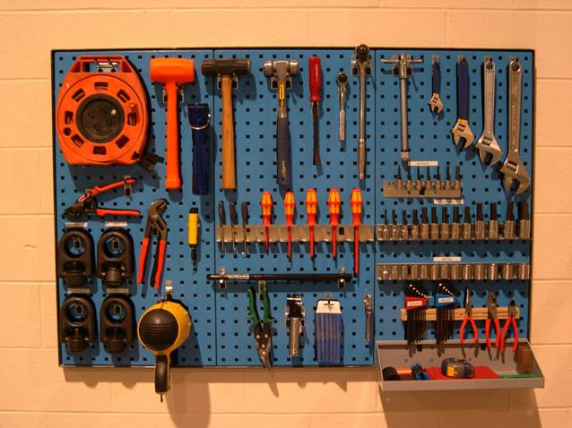
Set in Order (Seiton)
With your workplace cleaned up, it’s time to put everything in its place. How you organize your equipment will depend on your workspace’s needs, but the more organized and uniform your workplace, the safer and more efficient it is for your employees.

Slide 13
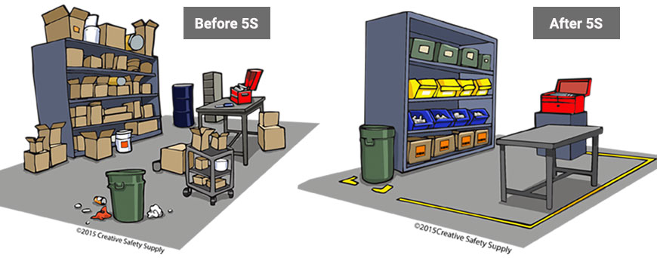
Shine (Seiso)
The regular cleaning and maintenance of equipment helps keep it running smoothly. It also allows employees to catch problems in the equipment and your systems before they become a

Slide 14
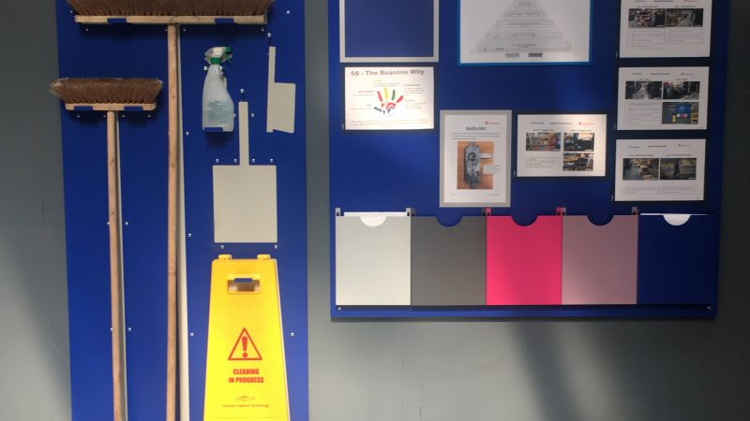
Standardized (Seiketsu)
Without standardization, your efforts so far will amount to nothing more than a good spring clean. Standardizing work processes and tasks ensures that every aspect of your work stays efficient.

Slide 15
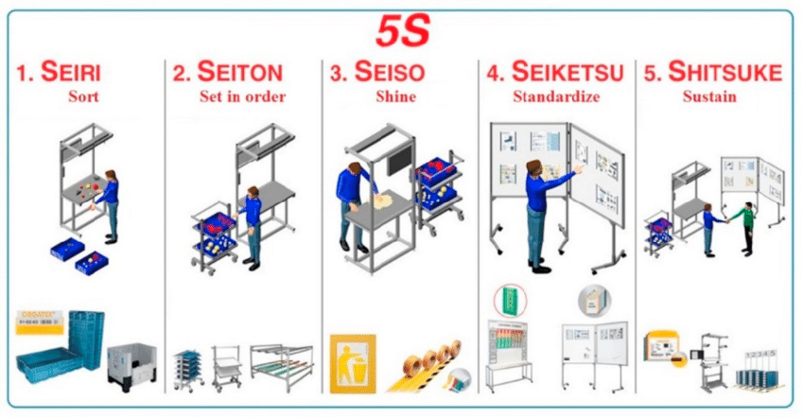
Sustain (Shitsuke)
In order to continue working efficiently, maintenance work is an absolute necessity. Standardizations make this easier to conduct and continue, as it is only in the long term that the principles of 5S or lean management truly come into effect.

Slide 16
